Slide 1
Introduction to Scala

Slide 2
Some Scala Facts
Scala is a general purpose programming language
Supports both Object-oriented and Functional Programming
Was released in Jan, 2004 first on JVM platform and later on .NET platform
Was developed by Martin Odersky and his team
Scala is a type-safe language (what does it mean??)
It is Statically Typed language that binds the type to a variable for its entire scope
Fully supports object-oriented programming.
Everything is an object in Scala. Even functions are objects in Scala
Unlike Java, there is no primitive in Scala (Int, Float, Double, Char etc. everything is an object)
Notes:
Type-safe: Type checking is performed at compile time rather than on run-time

Slide 3
Some Scala Facts contd..
Scala supports Functional Programming (FP)
In FP, functions are “First-class” citizens -> They can be assigned to variables, passed to other functions like any other values.
It allows for both Mutable and Immutable variables (Immutable fields can not be reassigned a value whereas Mutable fields can be)

Slide 4
Why Scala??
Developers prefer flexible programming languages like Scala to improve their productivity (mix of object-oriented and functional programming)
The JVM optimizations today allow Bytecode to outperform natively compiled codes
Scala has its scalac compiler, which also generates Bytecode (scala source files are compiled into class files)

Slide 5
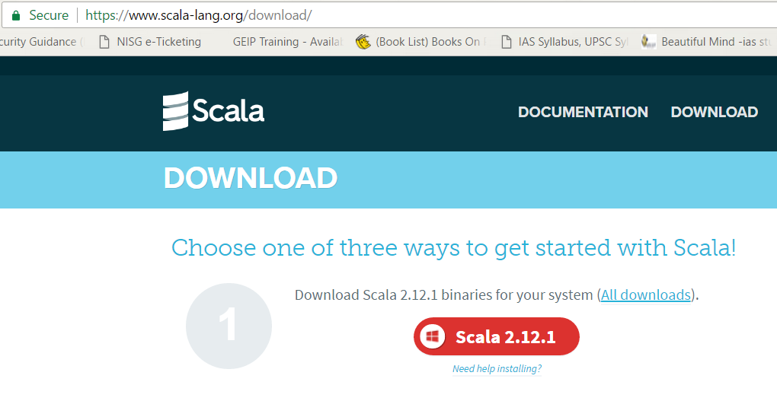
Programming environments: Scala REPL, Scala IDE for Eclipse
Download Scala binaries to install Scala and run Scala REPL
https://www.scala-lang.org/download/
Scala IDE for eclipse may be downloaded from:
http://scala-ide.org/download/current.html

Slide 6
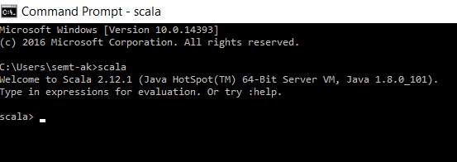
Programming environments: Scala REPL
Scala REPL (Read-Evaluate-Print Loop):
REPL is an Interactive shell interpreter for Scala programming
all typed code is converted to Bytecode and then executed
REPL is invoked by typing scala on command prompt

Slide 7
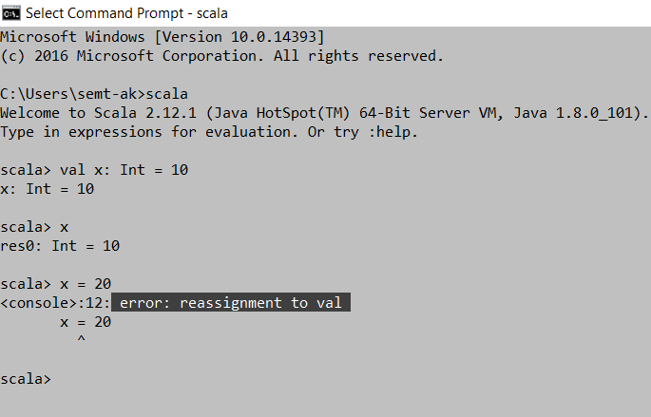
Basic programming with Scala
Declaring fields (Immutable vs. Mutable fields)
val : immutable field (it can’t be reassigned a value)
var: mutable field (can be reassigned any other value)

Slide 8
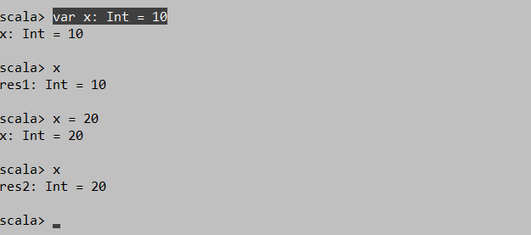
Basic programming contd..
Declaring fields (Immutable vs. Mutable fields)
val : immutable field (it can’t be reassigned a value)
var: mutable field (can be reassigned any other value)

Slide 9
Basic programming contd..
Declaring fields
val x: String = “Scala”
val x: Boolean = true
val x: Double = 10
val x: Float = 10f
OR just
val x = “Scala”
val x = true
val x = 10f
val x = 10.0
val x = 10

Slide 10
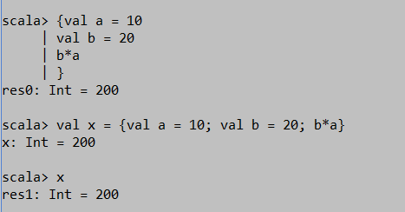

Block expressions
In Scala, { } is a list of expressions and result is also an expression
Last expression of the block is implicitly returned and assigned to a variable

Slide 11
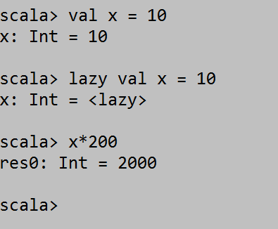
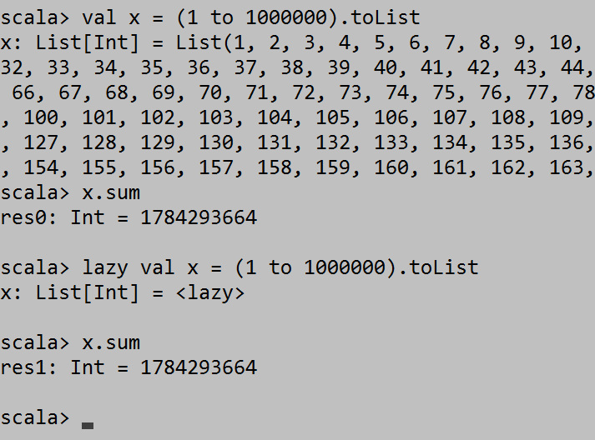
Just in Time/ On-demand/ Lazy loading
In Scala, lazy keyword is available to declare variables without allocating memory to them. This is useful in case of big data systems like Spark, where a variable can store huge amount of data making it very expensive on memory

Slide 12
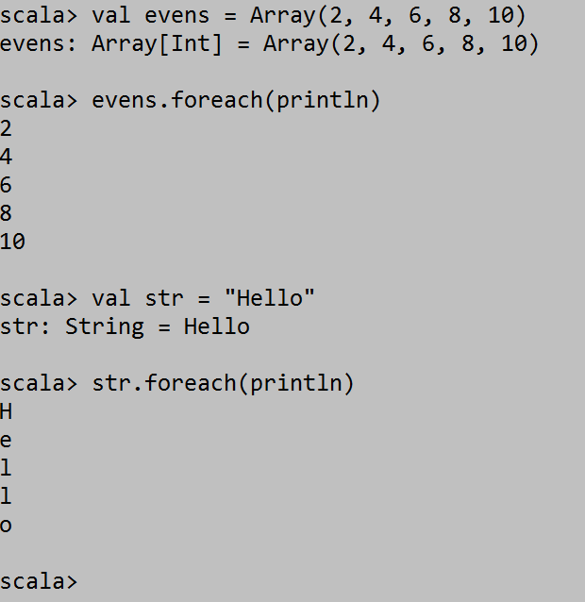
Loops/ Iterations with foreach()
foreach() function can be used for traversing collections in Scala.
As Scala is a functional programming language, another function can be passed as argument to foreach function

Slide 13
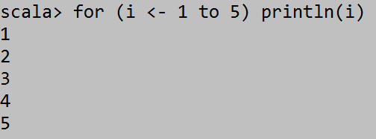
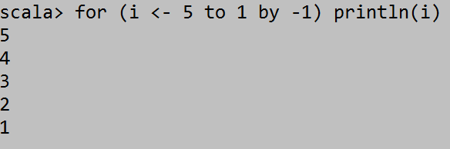
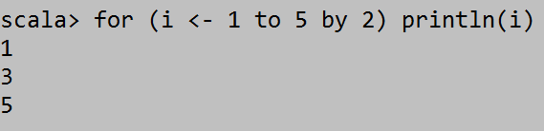
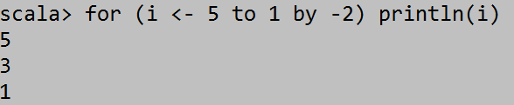
for loop
for loop in Scala can be used in many ways for performing iterative tasks
for (arg <- collection) code

Slide 14
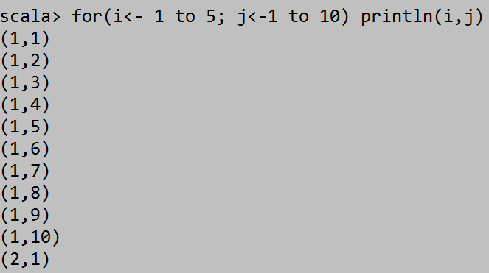
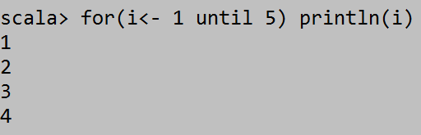
for loop contd..
for loop with multiple generators
for loop with until

Slide 15
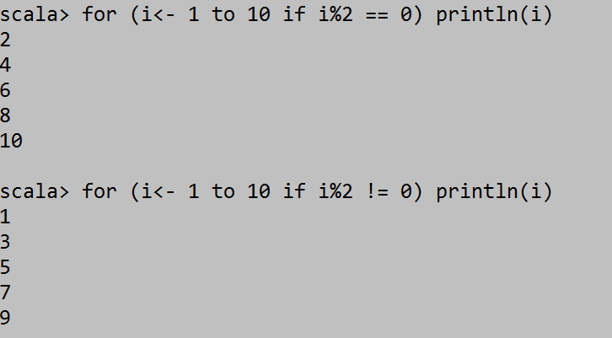
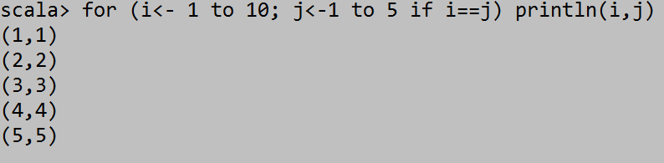
for loop with guard condition
for loop with guard condition can be used in many ways for performing conditional iterative tasks
for (args <- collection if statement) code

